Slide 1

Management Information System ( MIS )
Assignment#01
Notes:
To change the image on this slide, select the picture and delete it. Then click the Pictures icon in the placeholder to insert your own image.

Slide 2
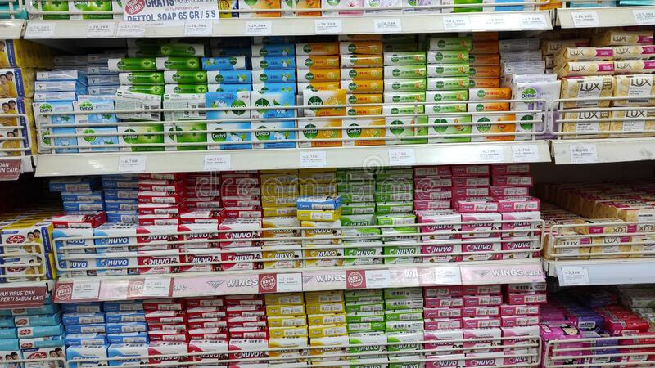
Market Research About Soaps in General Stores
We have visited to different general stores in the city to find out the market of Soaps in the city.

Slide 3
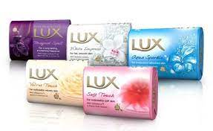
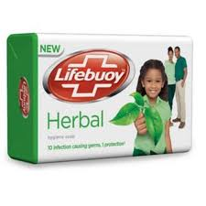
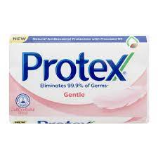
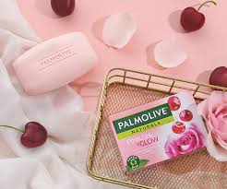
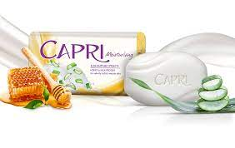
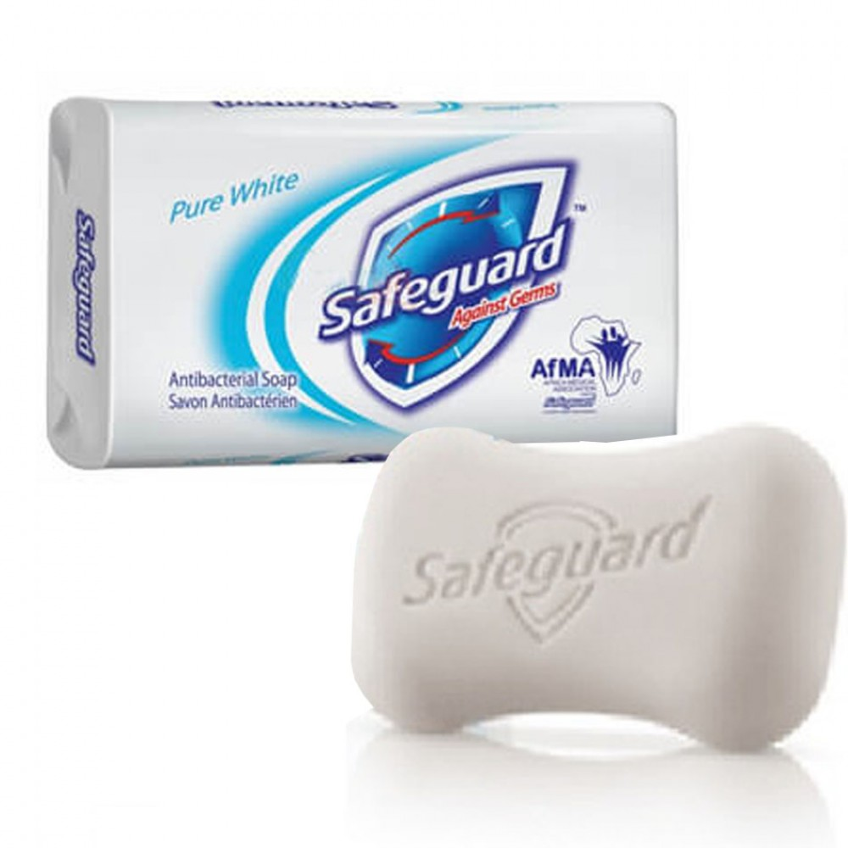
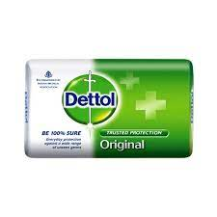
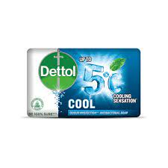
Soaps

Slide 4
Soaps
Capri
Dettol
Lifebuoy
Lux
Palmolive
Protex
Safeguard

Slide 5
UNILEVER
S.No | Product Name | Pack Size | Prices | Availability Status
1. | Lux | Small Large Family Pack | 88 Rs 107 Rs 385 Rs | Easily Available Easily Available Sometimes Available
2. | Lifebuoy | Small Large Family Pack | 80 Rs 110 Rs 270 Rs | Easily Available Easily Available Sometimes Available
INFORMATION
The Small and large Pack of LUX and Lifebuoy are available in approximately all store But the family pack of both products are not Available Because most of the peoples buy small and large size rather than Family Pack.

Slide 6
PROCTER & GAMBLE
S.No | Product Name | Pack Size | Prices | Availability Status
1. | Safeguard | Small Large Family Pack | 120 Rs 155 Rs 440 Rs | Easily Available Easily Available Sometimes Available
INFORMATION
The Small and large Pack of LUX and Lifebuoy are available in approximately all store But the family pack of both products are not Available Because most of the peoples buy small and large size rather than Family Pack.

Slide 7
PAKISTAN STANDARD
S.No | Product Name | Pack Size | Prices | Availability Status
1. | Capri | Small Large Family Pack | 90 Rs 110 Rs 350 Rs | Easily Available Easily Available Sometimes Available
INFORMATION

Slide 8
COLGATE-PALMOLIVE
S.No | Product Name | Pack Size | Prices | Availability Status
1. | Palmolive | Small Large Family Pack | 125 Rs 160 Rs 420 Rs | Easily Available Easily Available Sometimes Available
2. | Protex | Small Large Family Pack | 95 Rs 125 Rs 320 Rs | Easily Available Sometimes Available Sometimes Available
INFORMATION

Slide 9
RECKITT BENCKISER GROUPS
S.No | Product Name | Pack Size | Prices | Availability Status
1. | Dettol | Small Large Family Pack | 85 Rs 120 Rs 210 Rs | Easily Available Sometimes Available Sometimes Available
INFORMATION

Slide 10

Conclusion
We visit 10 different shops in different parts of Karachi. We ask some questions to the shopkeepers about the availability of products in terms of there sizes. We notice that the small and large pack of approximately all products are easily available at every store. Some stores are not selling the family pack because the family pack of every product can’t sell fast, most of the people buy small or large pack. So, in conclusion we can say that the family pack of each product are not easily available at stores.

Slide 11
TEAM MEMBERS
Huzaifa Khalid ( SE-211102 )
Zeeshan Javed ( SE-211067 )
Muhammad Hanzalah ( SE-211090 )

Slide 12


